Slide 1
Chapter 1: WAN Concepts
Instructor Materials
CCNA Routing and Switching
Connecting Networks v6.0
Notes:
Cisco Networking Academy Program
Connecting Networks v6.0
Chapter 1: WAN Concepts

Slide 2
Instructor Materials – Chapter 1 Planning Guide
This PowerPoint deck is divided in two parts:
Instructor Planning Guide
Information to help you become familiar with the chapter
Teaching aids
Instructor Class Presentation
Optional slides that you can use in the classroom
Begins on slide # 10
Note: Remove the Planning Guide from this presentation before sharing with anyone.
Notes:
2

Slide 3
Chapter 1: WAN Concepts
Connecting Networks 6.0 Planning Guide
Notes:
Cisco Networking Academy Program
Connecting Networks v6.0
Chapter 1: WAN Concepts

Slide 4
Chapter 7: Activities
What activities are associated with this chapter?
Page # | Activity Type | Activity Name | Optional?
1.1.1.9 | Interactive Activity | Identify WAN Topologies | Recommended
1.1.2.6 | Interactive Activity | Identify WAN Terminology | Recommended
1.2.1.3 | Interactive Activity | Classify WAN Access Options | Recommended
1.2.2.9 | Interactive Activity | Identify Private WAN Infrastructure Terminology | Recommended
1.2.3.6 | Interactive Activity | Identify Public WAN Infrastructure Terminology | Recommended
1.2.4.3 | Lab | Researching WAN Technologies | Optional
1.3.1.1 | Class Activity | WAN Device Modules | Optional
Notes:
4

Slide 5
Chapter 1: Assessment
Students should complete Chapter 1, “Assessment” after completing Chapter 1.
Quizzes, labs, Packet Tracers and other activities can be used to informally assess student progress.
Notes:
5

Slide 6
Chapter 1: Best Practices
Prior to teaching Chapter 1, the instructor should:
Complete Chapter 1, “Assessment.”
The objectives of this chapter are:
Explain the purpose of a WAN.
Explain how WANs operate.
Describe WAN services available.
Compare private WAN technologies.
Compare public WAN technologies.
Select the appropriate WAN protocol and service for a specific network requirement
Notes:
6

Slide 7
Chapter 1: Best Practices (Cont.)
Explain to students the WAN technologies and connection types used in their school.
Encourage the students to do all of the activities and labs in this chapter.
Ask students to discuss what type of Internet access they use from home or remote locations. In addition, ask the students what method of connectivity did they first start using when they initially connected to the Internet.
1.2.4.2
Another important question to answer when choosing a WAN Link Connection - "What is the budget for the WAN connection?"
Notes:
7

Slide 8
Chapter 1: Additional Help
For additional help with teaching strategies, including lesson plans, analogies for difficult concepts, and discussion topics, visit the CCNA Community at: https://www.netacad.com/group/communities/community-home
Best practices from around the world for teaching CCNA Routing and Switching. https://www.netacad.com/group/communities/ccna
If you have lesson plans or resources that you would like to share, upload them to the CCNA Community in order to help other instructors.
Students can enroll in Introduction to Packet Tracer (self-paced)
Notes:
8

Slide 10
Chapter 1: WAN Concepts
CCNA Routing and Switching
Connecting Networks v6.0
Notes:
Cisco Networking Academy Program
Connecting Networks v6.0
Chapter 1: WAN Concepts

Slide 11
Chapter 1 - Sections & Objectives
1.1 WAN Technologies Overview
Explain WAN access technologies available to small to medium-sized business networks.
Explain the purpose of a WAN.
Explain how WANs operate.
1.2 Selecting a WAN Technology
Select WAN access technologies to satisfy business requirements.
Describe WAN services available.
Compare private WAN technologies.
Compare public WAN technologies.
Select the appropriate WAN protocol and service for a specific network requirement.
Notes:
11
Cisco Networking Academy Program
Connecting Networks v6.0
Chapter 1: WAN Concepts

Slide 12
1.1 WAN Technologies Overview
Notes:
1- WAN concepts
1.1 – WAN Technologies Overview

Slide 13
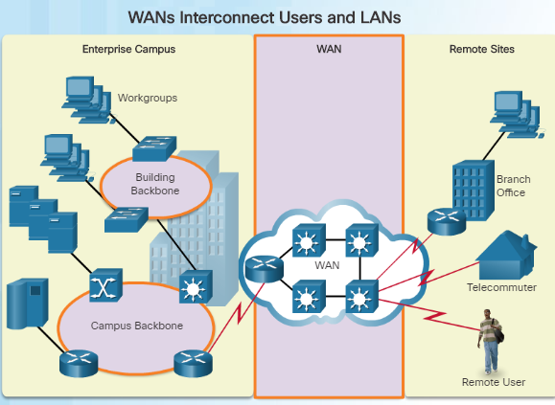
Purpose of WANs Why a WAN?
A WAN operates beyond the geographic scope of a LAN.
WANs are used to interconnect the enterprise LAN to remote LANs in branch sites and telecommuter sites.
A WAN is owned by a service provider whereas a LAN is typically owned by an organization.
An organization must pay a fee to use the WAN service provider’s network services to connect remote sites.
Service providers provide links to interconnect remote sites for the purpose of transporting data, voice, and video.
Notes:
1.1 – WAN Technologies Overview
1.1.1 – Purpose of WANs
1.1.1.1 – Why a WAN?

Slide 14
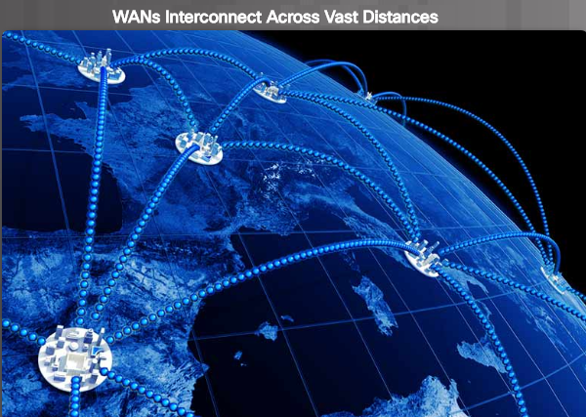
Purpose of WANs Are WANs Necessary?
Without WANs, LANs would be a series of isolated networks.
As organizations expand, businesses require the ability to communicate between geographically separated sites. For example:
Regional or branch offices of an organization need to be able to communicate and share data with the central site.
Organizations need to share information with other customer organizations.
Employees who travel on company business frequently need to access the corporate network.
In addition, consumers now commonly communicate over the Internet with banks, stores, and other providers of goods and services.
Notes:
1.1 – WAN Technologies Overview
1.1.1 – Purpose of WANs
1.1.1.2 – Are WANs Necessary?

Slide 15
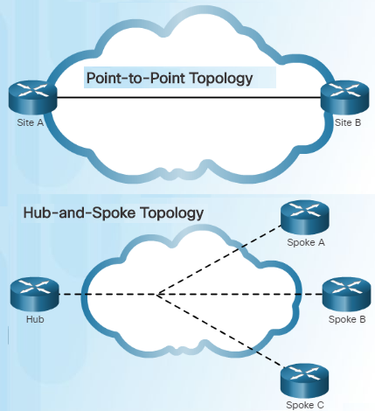
Purpose of WANs WAN Topologies
Interconnecting multiple sites across WANs can involve a variety of service provider technologies and WAN topologies. There are four Common WAN topologies.
Point-to-Point topology
Employs a point-to-point circuit between two endpoints
Typically involves a dedicated leased-line connection such as a T1/E1 line.
Transparent to the customer network and appears to be a direct physical link between two endpoints
Hub-and-Spoke
Applicable when a private network connection between multiple sites is required
A single interface to the hub can be shared by all spoke circuits.
Spoke sites can be interconnected through the hub site using virtual circuits and routed subinterfaces at the hub.
Notes:
1.1 – WAN Technologies Overview
1.1.1 – Purpose of WANs
1.1.1.3 – WAN Topologies

Slide 16
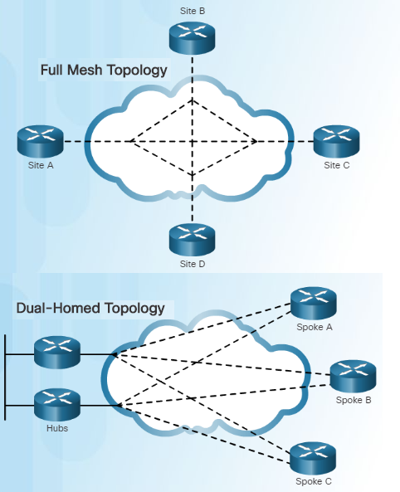
Purpose of WANs WAN Topologies (Cont.)
Full Mesh
A disadvantage of the hub-and-spoke topology is that all communication has to go through the hub.
With a full mesh topology using virtual circuits, any site can communicate directly with any other site.
A disadvantage is the large number of virtual circuits that need to be configured and maintained.
Dual-homed Topology
Provides redundancy and load balancing however they are more expensive to implement than single-homed topologies.
Requires additional networking hardware including routers and switches.
More difficult to implement since they require complex configurations.
Notes:
1.1 – WAN Technologies Overview
1.1.1 – Purpose of WANs
1.1.1.3 – WAN Topologies

Slide 17
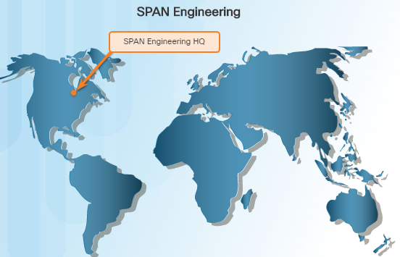
Purpose of WANs Evolving Networks
In slow economic times, many businesses focus on increasing their profitability by improving the efficiency of their existing operations – including establishing and managing their network.
To justify such a large expense, many companies expect their networks to perform optimally and to be able to deliver an increasing array of services and applications to support productivity and profitability.
This chapter will focus on a fictitious company called SPAN Engineering.
This topic will illustrate how SPAN’s network requirements change as the company grows from a small, local business into a global enterprise.
Notes:
1.1 – WAN Technologies Overview
1.1.1 – Purpose of WANs
1.1.1.4 – Evolving Networks

Slide 18
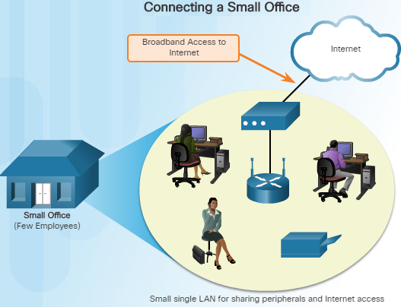
Purpose of WANs Small Office
SPAN Engineering:
Environmental consulting firm (4 years)
Has developed a special process for converting household waste into electricity and is developing a small pilot project for a municipal government in its local area.
15 employees: six engineers, four computer-aided drawing (CAD) designers, a receptionist, two senior partners and two office assistants
Small office uses a single LAN to share information between computers, support their VoIP phones, share peripherals, printer, and large-scale plotter
Connects to the Internet using DSL
Uses support services purchased from DSL provider for IT support.
Notes:
1.1 – WAN Technologies Overview
1.1.1 – Purpose of WANs
1.1.1.5 – Small Office

Slide 19
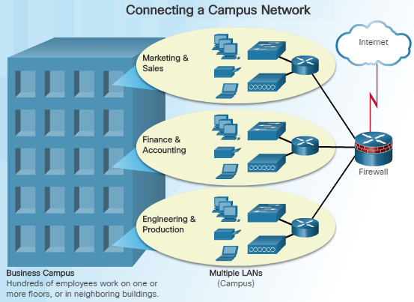
Purpose of WANs Campus Network
Five years later, SPAN Engineering has grown rapidly. The company was contracted to design and implement a full-sized waste conversion facility as well as other projects in neighboring municipalities and around the country.
The company is now classified as a small to medium-sized business with several hundred employees.
The company now occupies multiple floors of an office building.
The network has grown to several subnetworks which spans several floors of the building.
The business now has an in-house IT staff to support and maintain the network.
Notes:
1.1 – WAN Technologies Overview
1.1.1 – Purpose of WANs
1.1.1.6 – Campus Network

Slide 20
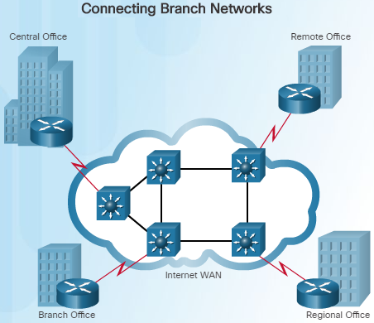
Purpose of WANs Branch Networks
Another six years later, SPAN Engineering has been so successful, they have expanded their operation and have opened small branch offices closer to the project sites.
The company was required to implement a WAN in order for the remote sites to be able to access the data center which houses various databases and servers.
The branch offices that are in nearby cities use private dedicated lines through their local service provider.
Offices that are located in other countries must use the Internet for their WAN connection.
Notes:
1.1 – WAN Technologies Overview
1.1.1 – Purpose of WANs
1.1.1.7 – Branch Networks

Slide 21
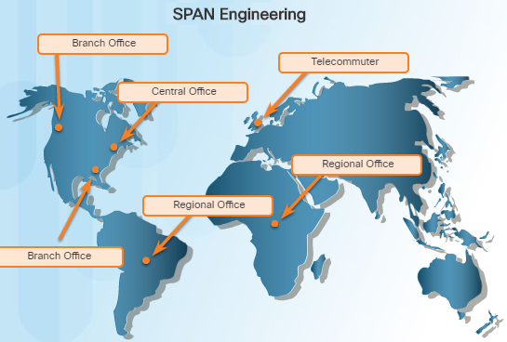
Purpose of WANs Distributed Network
SPAN Engineering has now been in business for 20 years and has grown to thousands of employees distributed in offices worldwide.
The cost of the network and its related services is a significant expense.
To increase profitability, the company must reduce its operating expense.
What methods has the company used to reduce its operating costs?
To meet the new requirements, the network must provide the necessary converged service and secure Internet WAN connectivity to remote sites.
As seen in this example, network requirements of a company can change dramatically as a company grows over time.
Notes:
1.1 – WAN Technologies Overview
1.1.1 – Purpose of WANs
1.1.1.8 – Distributed Network

Slide 22
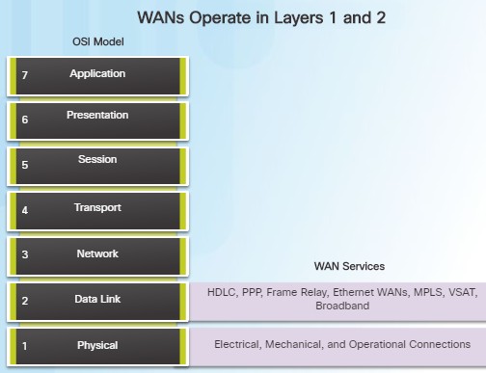
WAN Operations WANs in the OSI Model
WAN operations focus primarily on the physical and data link layer of the OSI Model.
Data link layer requirements include physical addressing, flow control and encapsulation.
WAN access standards are defined and managed by a number of recognized authorities:
TIA/EIA (Telecommunications Industry Association and the Electronic Industries Alliance)
ISO (International Organization for Standardization)
IEEE (Institute of Electrical and Electronics Engineers)
Layer 1 protocols describe how to provide electrical, mechanical, operational, and functional connects to the services of a communications service provider.
Layer 2 protocols define how data is encapsulated and the mechanisms for transferring the resulting frames.
Notes:
1.1 – WAN Technologies Overview
1.1.2 – WAN Operations
1.1.2.1 – WANs in the OSI Model

Slide 23
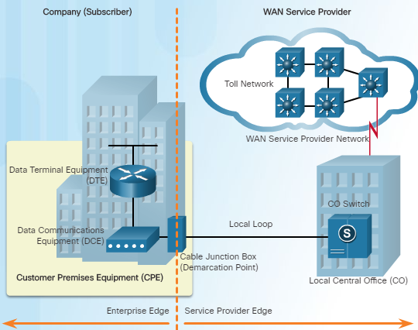
WAN Operations Common WAN Terminology
One primary difference between a WAN and a LAN is that a company must subscribe to an outside WAN service provider to use WAN carrier network services.
Terminology commonly used to describe WAN connections:
Customer Premises Equipment (CPE) –Consists of devices and inside wiring located on the enterprise edge connecting to a carrier
Data Communications Equipment (DCE) – Also called circuit-terminating equipment, the DCE consists of devices that put data on the local loop. The DCE primarily provides an interface to connect subscribers to a communication link on the WAN cloud.
Notes:
1.1 – WAN Technologies Overview
1.1.2 – WAN Operations
1.1.2.2 – Common WAN Terminology

Slide 24
WAN Operations Common WAN Terminology (Cont.)
Data Terminal Equipment (DTE) – The customer devices that pass the data from a customer network or host computer for transmission over the WAN. The DTE connects to the local loop through the DCE.
Demarcation Point – This is a point established in a building to separate customer equipment from service provider equipment.
Local Loop (“last mile”) – The actual copper or fiber cable that connects the CPE to the CO of the service provider.
Central Office (CO) – The CO is the local service provider facility or building that connects the CPE to the provider network.
Toll network – This consists of the long-haul, all-digital, fiber-optic communications lines and other equipment inside the WAN provider network.
Notes:
1.1 – WAN Technologies Overview
1.1.2 – WAN Operations
1.1.2.2 – Common WAN Terminology

Slide 25
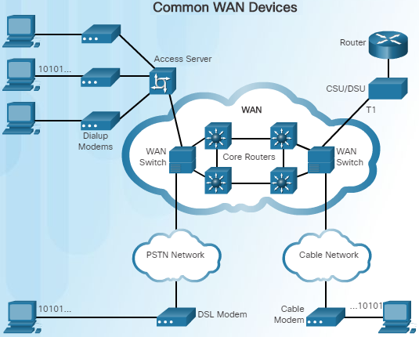
WAN Operations WAN Devices
There are many types of devices that are specific to WAN environments:
Dialup modem – Legacy WAN technology that converts (modulates) the digital signals produced by a computer into voice frequencies which are transmitted over the analog lines of the public telephone network to another modem for demodulation.
Access server – Legacy technology where the server controls and coordinates dialup modem, dial-in and dial-out user communications.
Broadband modem – A type of digital modem used with high-speed DSL or cable Internet service. Both operate in a similar manner to the voiceband modem, but use higher broadband frequencies and transmission speeds.
Notes:
1.1 – WAN Technologies Overview
1.1.2 – WAN Operations
1.1.2.3 – WAN Devices

Slide 26
WAN Operations WAN Devices (Cont.)
CSU/DSU - Digital-leased lines require a CSU and a DSU. The CSU provides termination for the digital signal and ensures connection integrity through error correction and line monitoring. The DSU converts line frames into frames that the LAN can interpret and vice versa.
Router – Provides internetworking and WAN access interface ports that are used to connect to the service provider.
Core router/Multilayer switch – A router or multilayer switch that resides within the middle or backbone of the WAN.
Notes:
1.1 – WAN Technologies Overview
1.1.2 – WAN Operations
1.1.2.3 – WAN Devices

Slide 27
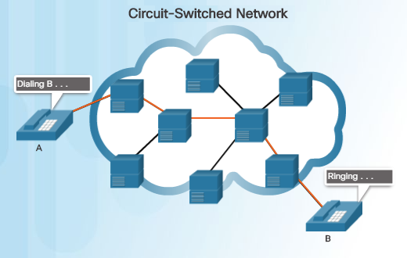
WAN Operations Circuit Switching
A circuit-switched network is one that establishes a dedicated circuit (or channel) between nodes and terminals before the users may communicate.
Circuit switching dynamically establishes a dedicated virtual connection for voice or data between a sender and a receiver.
Communication can't start until the connection is established through the service provider network.
Dialing a number to make a call is an example of circuit switching technology.
The two most common types of circuit-switched WAN technologies are the public switched telephone network (PSTN) and the Integrated Services Digital Network (ISDN).
Notes:
1.1 – WAN Technologies Overview
1.1.2 – WAN Operations
1.1.2.4 – Circuit Switching

Slide 28
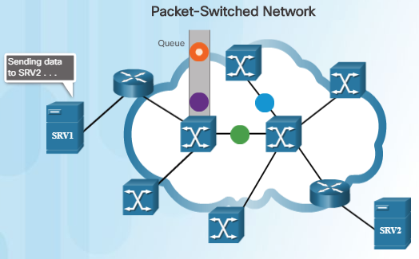
WAN Operations Packet Switching
In contrast to circuit switching, packet switching splits traffic data into packets that are routed over a shared network.
A circuit does not need to be established and many pairs of nodes can communicate over the same channel.
There are two approaches to packet-switched network link determination:
Connectionless systems – Full addressing information must be carried in each packet. The Internet is an example of a connectionless system.
Connection-oriented systems – The network predetermines the route for a packet, and each packet only has to carry an identifier. An example of a connection-oriented system is Frame Relay (DLCIs are the identifiers).
Packet switching costs less than circuit switching, however, latency and jitter are greater in packet-switching networks.
Notes:
1.1 – WAN Technologies Overview
1.1.2 – WAN Operations
1.1.2.5 – Packet Switching

Slide 29
1.2 Selecting a WAN Technology
Notes:
1- WAN Concepts
1.2 – Selecting a WAN Technology

Slide 30
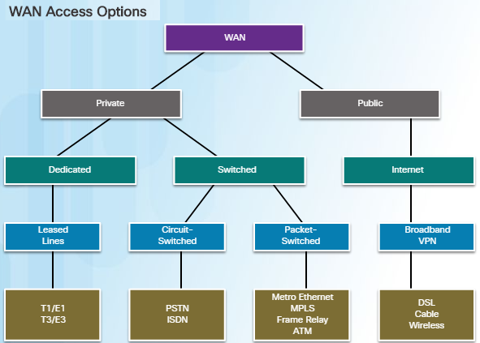
WAN Services WAN Link Connection Options
There are several WAN access connection options that ISPs can use to connect the local loop to the enterprise edge.
Each option has distinct advantages and disadvantages as well as differences with technology, speed, and cost.
There are two ways an enterprise can obtain WAN access:
Private WAN infrastructure – Choices may include dedicated point-to-point leased lines, circuit-switched links such as PSTN or ISDN, and packet switched links such as Ethernet WAN, ATM, or Frame Relay.
Public WAN infrastructure – Service providers may offer broadband Internet using DSL, cable, or satellite access. Data traveling between corporate sites over a public WAN should be protected using VPNs.
Notes:
1.2 – Selecting a WAN Technology
1.2.1 – WAN Services
1.2.1.1 – WAN Link Connection Options

Slide 31
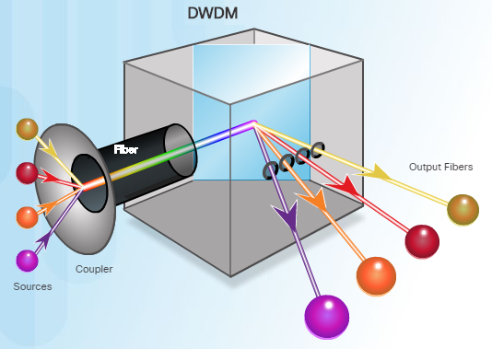
WAN Services Service Provider Network Infrastructure
Service provider networks are complex and consist mostly of high-bandwidth fiber-optic media, using either Synchronous Optical Networking (SONET) or Synchronous Digital Hierarchy (SDH) standard.
A newer fiber-optic media development for long-range communications is called dense wavelength division multiplexing (DWDM).
Multiplies the amount of bandwidth that a single strand of fiber can support
Enables bidirectional communications over one strand of fiber
Can multiplex more than 80 different channels of data onto a single fiber
Each channel can carry a 10 Gb/s multiplexed signal
Notes:
1.2 – Selecting a WAN Technology
1.2.2 – WAN Services
1.2.1.2 – Service Provider Network Infrastructure

Slide 32
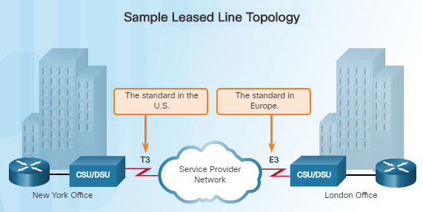
Private WAN Infrastructures Leased Lines
Point-to-point lines are usually leased from a service provider and are called leased lines. However, since they have been around since the 1950s, they are sometimes referred to as:
Leased circuits
Serial link
Serial line
Point-to-point link
T1/E1 or T3/E3 lines
Leased lines vary in price depending on the bandwidth required and the distance between the two connected paths.
In North America, service providers use the T-carrier system to define the digital transmission capacity of a serial copper media link. For example, a T1 link supports 1.544 Mb/s.
When permanent dedicated connections are required, a point-to-point link is used to provide a pre-established WAN communications path from the customer premises to the provider network.
Notes:
1.2 – Selecting a WAN Technology
1.2.2 – Private WAN Infrastructures
1.2.2.1 – Leased Lines

Slide 33
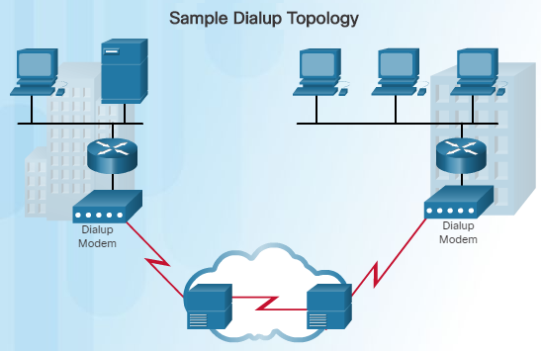
Private WAN Infrastructures Dialup
Dialup WAN access may be required when no other WAN technology is available.
For example, a remote location could use modems and analog telephone lines to provide low capacity and dedicated switched connections.
Traditional local loops, which use copper cabling, transport binary computer data through the voice telephone network using a modem.
A modem modulates the binary data into an analog signal at the source and demodulates the analog signal to binary data at the destination.
The physical characteristics of the local loop and its connected to the PSTN limit the rate of the signal to less than 56 kb/s.
WAN built with an on demand connection using a modem and the voice telephone network
Notes:
1.2 – Selecting a WAN Technology
1.2.2 – Private WAN Infrastructures
1.2.2.2 – Dialup

Slide 34
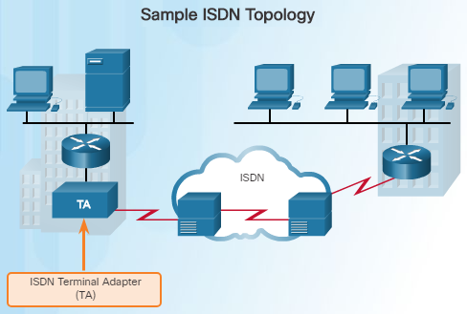
Private WAN Infrastructures ISDN
Integrated Services Digital Network (ISDN) is a circuit-switching technology that enables the local loop of a PSTN to carry digital signals, resulting in higher capacity switched connections.
ISDN changes the internal connections of the PSTN from carrying analog signals to time-division multiplexed (TDM) digital signals.
TDM allows two or more signals, or bit streams, to be transferred as subchannels in one communication channel.
The ISDN connection may require a terminal adapter (TA) which is a device used to connect ISDN Basic Rate Interface (BRI) connections to a router.
Notes:
1.2 – Selecting a WAN Technology
1.2.2 – Private WAN Infrastructures
1.2.2.3 – ISDN

Slide 35
Private WAN Infrastructures ISDN (Cont.)
There are two types of ISDN Interfaces:
Basic Rate Interface (BRI) – ISDN BRI provides two 64 kb/s bearer channels (B) for carrying voice and data and a 16 kb/s delta channel (D) for signaling, call setup and other purposes.
Primary Rate Interface (PRI) – In North America, PRI delivers 23 B channels with 64 kb/s and one D channel with 64 kb/s for a total bit rate of up to 1.544 Mb/s. This includes some additional overhead for synchronization.
A common application of ISDN is to provide additional capacity as needed on a leased line connection. ISDN can also be used as a backup if the leased line fails.
Although ISDN is still an important technology for telephone service provider networks, it has declined in popularity due to DSL and other broadband services.
Notes:
1.2 – Selecting a WAN Technology
1.2.2 – Private WAN Infrastructures
1.2.2.3 – ISDN

Slide 36
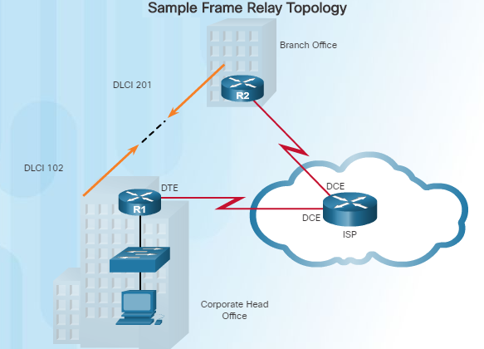
Private WAN Infrastructures Frame Relay
Frame Relay is a Layer 2 non-broadcast multi-access (NBMA) WAN technology used to interconnect enterprise LANs.
Data rates of up to 4 Mb/s with some providers offering higher rates
A single router can be used to connect multiple sites using PVCs which can carry both voice and data traffic.
An edge router only requires a single interface, even when multiple virtual circuits are used.
Frame Relay creates PVCs which are uniquely identified by a data-link connection identifier (DLCI). The PVCs and DLCIs ensure bidirectional communication between one DTE device to another.
Notes:
1.2 – Selecting a WAN Technology
1.2.2 – Private WAN Infrastructures
1.2.2.4 – Frame Relay

Slide 37
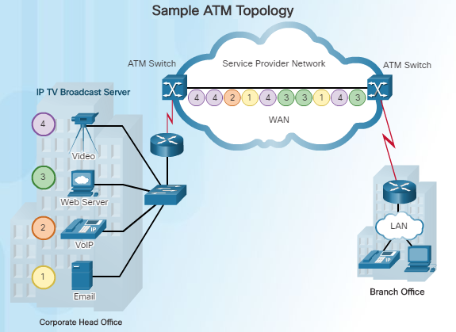
Private WAN Infrastructures ATM
Asynchronous Transfer Mode (ATM) technology is capable of transferring voice, video, and data through private and public networks.
ATM is built on a cell-based architecture rather than on a frame-based architecture.
Cells are always a fixed length of 53 bytes.
ATM cells contain a 5-byte ATM header followed by 48 bytes of ATM payload.
Small fixed-length cells are well-suited for voice and video traffic.
A typical ATM line needs almost 20% greater bandwidth than Frame Relay to carry the same volume of network traffic.
When the cell is carrying segmented network layer traffic, the overhead is higher since the ATM switch must be able to reassemble the packets at the destination.
Notes:
1.2 – Selecting a WAN Technology
1.2.2 – Private WAN Infrastructures
1.2.2.5 – ATM

Slide 38
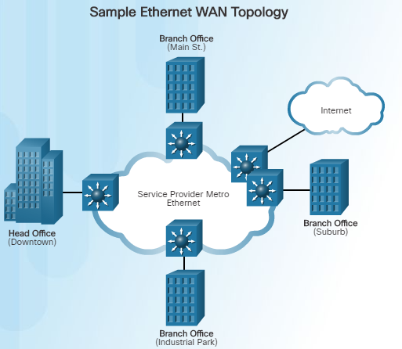
Private WAN Infrastructures Ethernet WAN
Thanks to newer Ethernet standards using fiber-optic cables, Ethernet is now a reasonable WAN access option.
The original maximum cable length for Ethernet was one kilometer.
With fiber-optic cable, the maximum length is 5 km using IEEE 10000Base-LX, and 70 km using IEEE 1000BASE-ZX standards.
Service providers now offer Ethernet WAN service using fiber-optic cabling which provide several benefits:
Reduced expenses and administration
Easy integration with existing networks
Enhanced business productivity
Ethernet WANs are commonly being used to replace Frame Relay and ATM WAN links.
Notes:
1.2 – Selecting a WAN Technology
1.2.2 – Private WAN Infrastructures
1.2.2.6 – Ethernet WAN

Slide 39
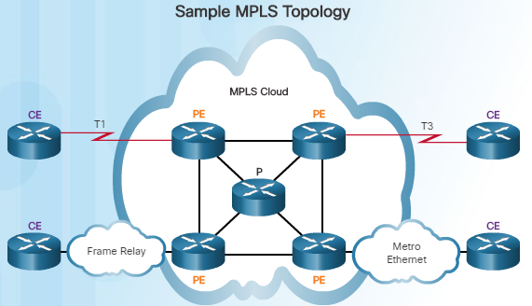
Private WAN Infrastructures MPLS
Multiprotocol Label Switching (MPLS) is a multiprotocol high-performance WAN technology that directs data from one router to the next.
MPLS is based on short path labels rather than IP network addresses.
It is called Multiprotocol since it has the ability to carry any payload including IPv4, IPv6, Ethernet, ATM, DSL, and Frame Relay traffic.
It uses labels which tell the router what to do with a packet.
Notice in the figure to the left that different sites can connect to the MPLS cloud using different access technologies.
MPLS can support a wide range of WAN technologies including T-carrier / E-carrier links, Carrier Ethernet, ATM, Frame Relay, and DSL.
MPLS is primarily a service provider WAN technology.
Notes:
1.2 – Selecting a WAN Technology
1.2.2 – Private WAN Infrastructures
1.2.2.7 – MPLS

Slide 40
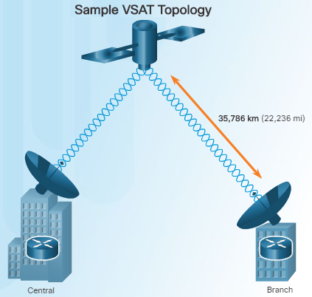
Private WAN Infrastructures VSAT
All private WAN technologies discussed so far used either copper or fiber-optic media.
What if an organization needed connectivity in a remote location where there are no service providers that offer WAN service?
Very small aperture terminal (VSAT) is a solution that creates a private WAN using satellite communications.
A VSAT is a small satellite dish used to create a private WAN that provides connectivity to remote locations.
The satellite is in geosynchronous orbit in space. The signals travel approximately 35,786 kilometers to the satellite and back.
Notes:
1.2 – Selecting a WAN Technology
1.2.2 – Private WAN Infrastructures
1.2.2.7 – VSAT

Slide 41
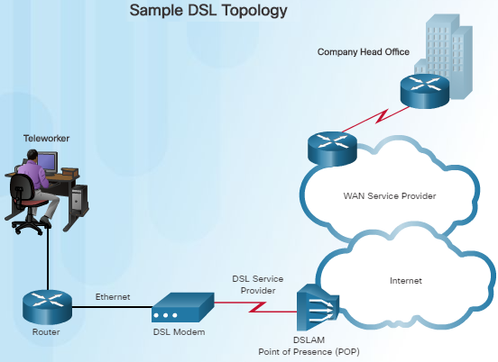
Public WAN Infrastructures DSL
DSL is an always-on connection technology that uses existing twisted-pair telephone lines to transport high-bandwidth data, and provides IP services to subscribers.
A DSL modem is required which converts an Ethernet signal from the user device to a DSL signal, which is transmitted to the central office.
Multiple DSL subscriber lines are multiplexed into a single high-capacity link using a DSLAM at the provider location.
DSL is a popular choice for IT departments to support home workers.
A subscriber must first connect to an ISP and then an IP connection is made through the Internet to the enterprise network.
Notes:
1.2 – Selecting a WAN Technology
1.2.3 – Public WAN Infrastructures
1.2.3.1 – DSL

Slide 42
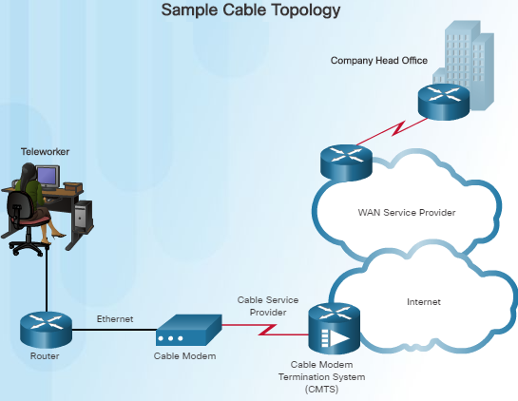
Public WAN Infrastructures Cable
Network access is available from many cable television providers (using coaxial cable) which allows for greater bandwidth than the conventional telephone local loop.
Cable modems provide an always-on connection and a simple installation.
A subscriber connects a computer or a LAN router to the cable modem, which translates the digital signals into broadband frequencies used for transmitting on a cable television network.
The cable modem termination system (CMTS), which is a component located at the local cable TV office (headend), sends and receives digital cable modem signals on a cable network and is necessary for providing Internet services to subscribers.
Notes:
1.2 – Selecting a WAN Technology
1.2.3 – Public WAN Infrastructures
1.2.3.2 – Cable

Slide 43
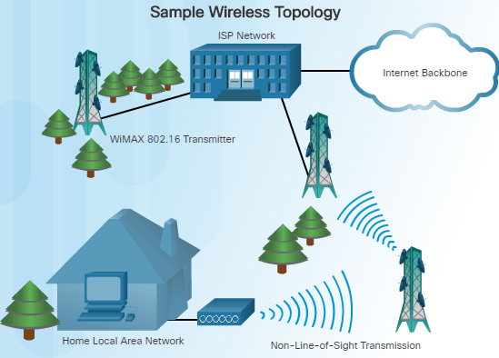
Public WAN Infrastructures Wireless
Until recently, one limitation of wireless access has been the need to be within the local transmission range (typically less than 100 feet) of a wireless router or a wireless modem. The following new developments are changing this:
Municipal Wi-Fi – Many cities have begun setting up municipal wireless networks for free or for substantially less than broadband.
WiMAX (IEEE 802.16) – Worldwide Interoperability for Microwave Access (WiMAX) is a new high-speed broadband technology that is just beginning to come into use. WiMAX provides broad coverage similar to a cell phone network rather than through Wi-Fi hotspots. WiMAX operates similar to Wi-Fi, but at higher speeds and over longer distances.
Notes:
1.2 – Selecting a WAN Technology
1.2.3 – Public WAN Infrastructures
1.2.3.3 – Wireless

Slide 44
Public WAN Infrastructures Wireless (Cont.)
WiMAX uses a network of WiMAX towers that are similar to cell phone towers. Subscribers must be within 30 miles of a tower.
Satellite Internet – Typically used by rural users where cable and DSL are not available. A VSAT provides two-way (upload and download) data communications. The upload speed is about one-tenth of the 500 kb/s download speed. Cable and DSL have higher download speeds, but satellite systems are about 10 times faster than analog modems.
Notes:
1.2 – Selecting a WAN Technology
1.2.3 – Public WAN Infrastructures
1.2.3.3 – Wireless

Slide 45
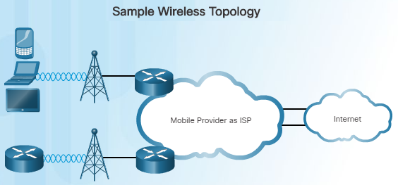
Public WAN Infrastructures 3G/4G Cellular
Increasingly, cellular service is another wireless WAN technology being used to connect users and remote locations where no other WAN access technology is available.
Phones, tablet computers, laptops, and even some routers can communicate through to the Internet using cellular technology.
These devices use radio waves to communicate through a nearby mobile phone tower. The device has a small radio antenna, and the provider has a much larger antenna sitting at the top of the tower somewhere within miles of the phone.
There are two common cellular industry terms:
3G/4G Wireless – Abbreviation for 3rd and 4th generation cellular access.
Long-Term Evolution (LTE) – Refers to a newer and faster technology and is considered to be part of the fourth generation (4G) technology.
Notes:
1.2 – Selecting a WAN Technology
1.2.3 – Public WAN Infrastructures
1.2.3.4 – 3G/4G Cellular

Slide 46
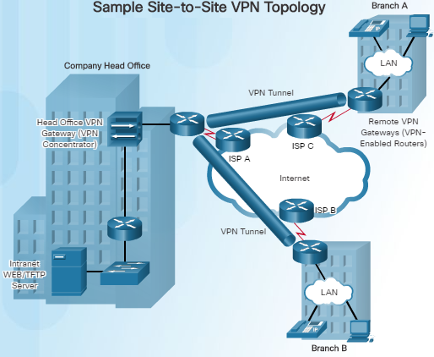
Public WAN Infrastructures VPN Technology
Due to security risks, VPNs are needed when a teleworker or a remote office uses a broadband service to access the corporate WAN over the Internet.
A VPN is an encrypted connection between private networks over a public network, such as the Internet.
Instead of using a dedicated Layer 2 connection such as a leased line, a VPN uses virtual connections called VPN tunnels, which are routed through the Internet from the private network of the company to the remote site or employee host.
Notes:
1.2 – Selecting a WAN Technology
1.2.3 – Public WAN Infrastructures
1.2.3.5 – VPN Technology

Slide 47
Public WAN Infrastructures VPN Technology (Cont.)
There are several benefits to using VPNs:
Cost savings
Security
Scalability
Compatibility with broadband technology
There are two types of VPN access:
Site-to-site VPNs – Connects entire networks to each other; for example, they can connect a branch office network to a company headquarters network.
Remote-access VPNs – Enables telecommuters, mobile users, and extranet consumers to access a company network securely over the Internet.
Notes:
1.2 – Selecting a WAN Technology
1.2.3 – Public WAN Infrastructures
1.2.3.5 – VPN Technology

Slide 48
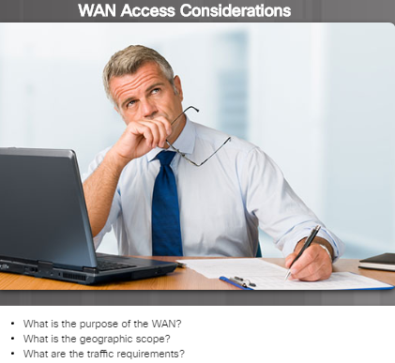
Selecting WAN Services Choosing a WAN Link Connection
There are many factors to consider when choosing an appropriate WAN connection. Network administrators must answer numerous questions including:
What is the purpose of the WAN?
Will the enterprise connect local branches in the same city area, connect remote branches, or connect to a single branch?
Will the WAN be used to connect internal or external employees or customers?
What is the geographic scope?
Is the WAN local, regional, or global?
Is the WAN one-to-one (single branch), one-to-many branches, or many-to-many (distributed)?
What are the traffic requirements?
What type of traffic must be supported?
What are the quality and performance requirements?
What Quality of Service is required?
Notes:
1.2 – Selecting a WAN Technology
1.2.4 – Selecting WAN Services
1.2.4.1 – Choosing a WAN Link Connection

Slide 49
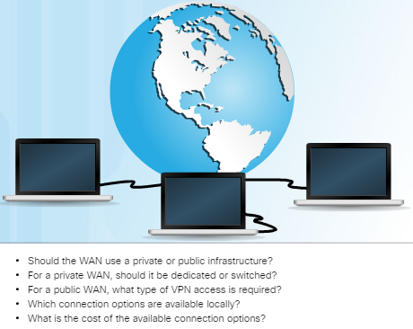
Selecting WAN Services Choosing a WAN Link Connection (Cont.)
Should the WAN use private or public infrastructure?
Private infrastructure – offers the best security
Public Internet infrastructure – not as secure, but offers the most flexibility and lowest ongoing expense
For a private WAN, should it be dedicated or switched?
For a public WAN, what type of VPN access is required?
Which connection options are available locally?
What are the costs of the connection options available?
Notes:
1.2 – Selecting a WAN Technology
1.2.4 – Selecting WAN Services
1.2.4.2 – Choosing a WAN Link Connection (Cont.)

Slide 50
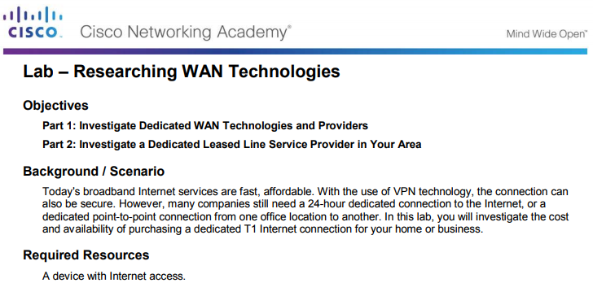
Selecting WAN Services Lab – Researching WAN Technologies
In this lab, you will be required to investigate the cost and availability of purchasing a dedicated T1 Internet connection for your home or business.
Notes:
1.2 – Selecting a WAN Technology
1.2.4 – Selecting WAN Services
1.2.4.3 – Lab – Researching WAN Technologies

Slide 51
1.3 Summary
Notes:
1 – WAN Concepts
1.3 – Summary

Slide 52
Summary Conclusion
Explain WAN access technologies available to small to medium-sized business networks.
Select WAN access technologies to satisfy business requirements.
Notes:
1.3 – Summary
1.3.1 – Conclusion
1.3.1.1 – Chapter 1: WAN Concepts

Slide 53
Chapter 1 New Terms and Commands
service provider Point-to-Point topology Hub-and-Spoke topology Full Mesh topology Dual-Homed topology leased line T1 E1 hub single-homed topology Voice over IP (VoIP) broadband service Digital Subscriber Line (DSL) | dedicated lines enterprise network teleworking Virtual Private Networks (VPNs) Telecommunications Industry Association (TIA) Electronic Industries Alliance (EIA) International Organization for Standardization (ISO) Institute of Electrical and Electronics Engineers (IEEE) Point-to-Point Protocol (PPP) Frame Relay Asynchronous Transfer Mode (ATM)
Notes:
New Terms and Commands

Slide 54
Chapter 1 New Terms and Commands (Cont.)
High-Level Data Link Control (HDLC) Customer Premises Equipment (CPE) Data Communications Equipment (DCE) Data Terminal Equipment (DTE) Demarcation Point Local Loop last-mile Central Office (CO) Toll network Dialup modem modulates demodulates Access server | Broadband modem Channel service unit/data service unit (CSU/ DSU) WAN switch circuit-switched network public switched telephone network (PSTN) Integrated Services Digital Network (ISDN) packet-switched network virtual circuit (VC) data-link connection identifiers (DLCIs) latency jitter Private WAN infrastructure Public WAN infrastructure
Notes:
New Terms and Commands

Slide 55
Chapter 1 New Terms and Commands (Cont.)
Broadband connections Synchronous Optical Networking (SONET) Synchronous Digital Hierarchy (SDH) light-emitting diodes (LEDs) dense wavelength division multiplexing (DWDM) multiplex Optical Carrier (OC) time-division multiplexed (TDM) Basic Rate Interface (BRI) Primary Rate Interface (PRI) non-broadcast multi-access (NBMA) permanent virtual circuits (PVCs) Metropolitan Ethernet (MetroE) Ethernet over MPLS (EoMPLS) | Virtual Private LAN Service (VPLS) Multiprotocol Label Switching (MPLS) Very small aperture terminal (VSAT) DSL modem DSL access multiplexer (DSLAM) point of presence (POP) Cable modems (CM) headend cable modem termination system (CMTS) Municipal Wi-Fi WiMAX Satellite Internet 3G/4G Wireless Long-Term Evolution (LTE)
Notes:
New Terms and Commands

Slide 56
Chapter 1 New Terms and Commands (Cont.)
teleworker Site-to-site VPNs Remote-access VPNs
Notes:
New Terms and Commands

